Slide 1
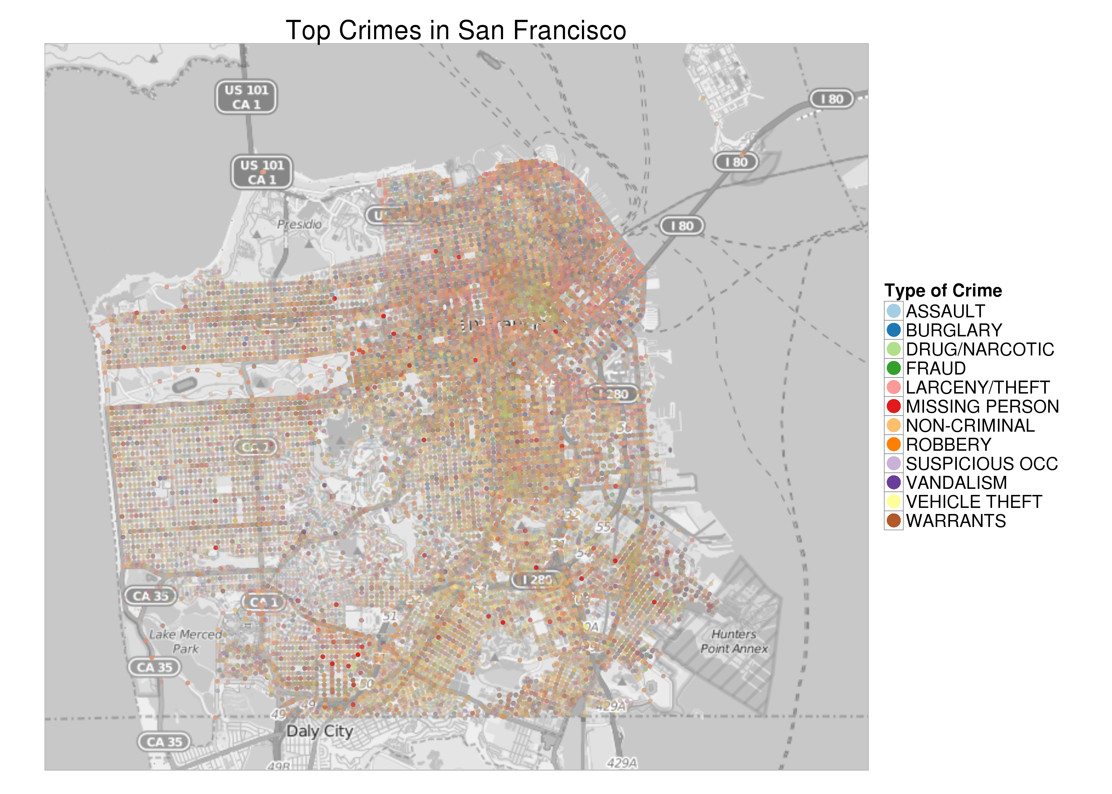
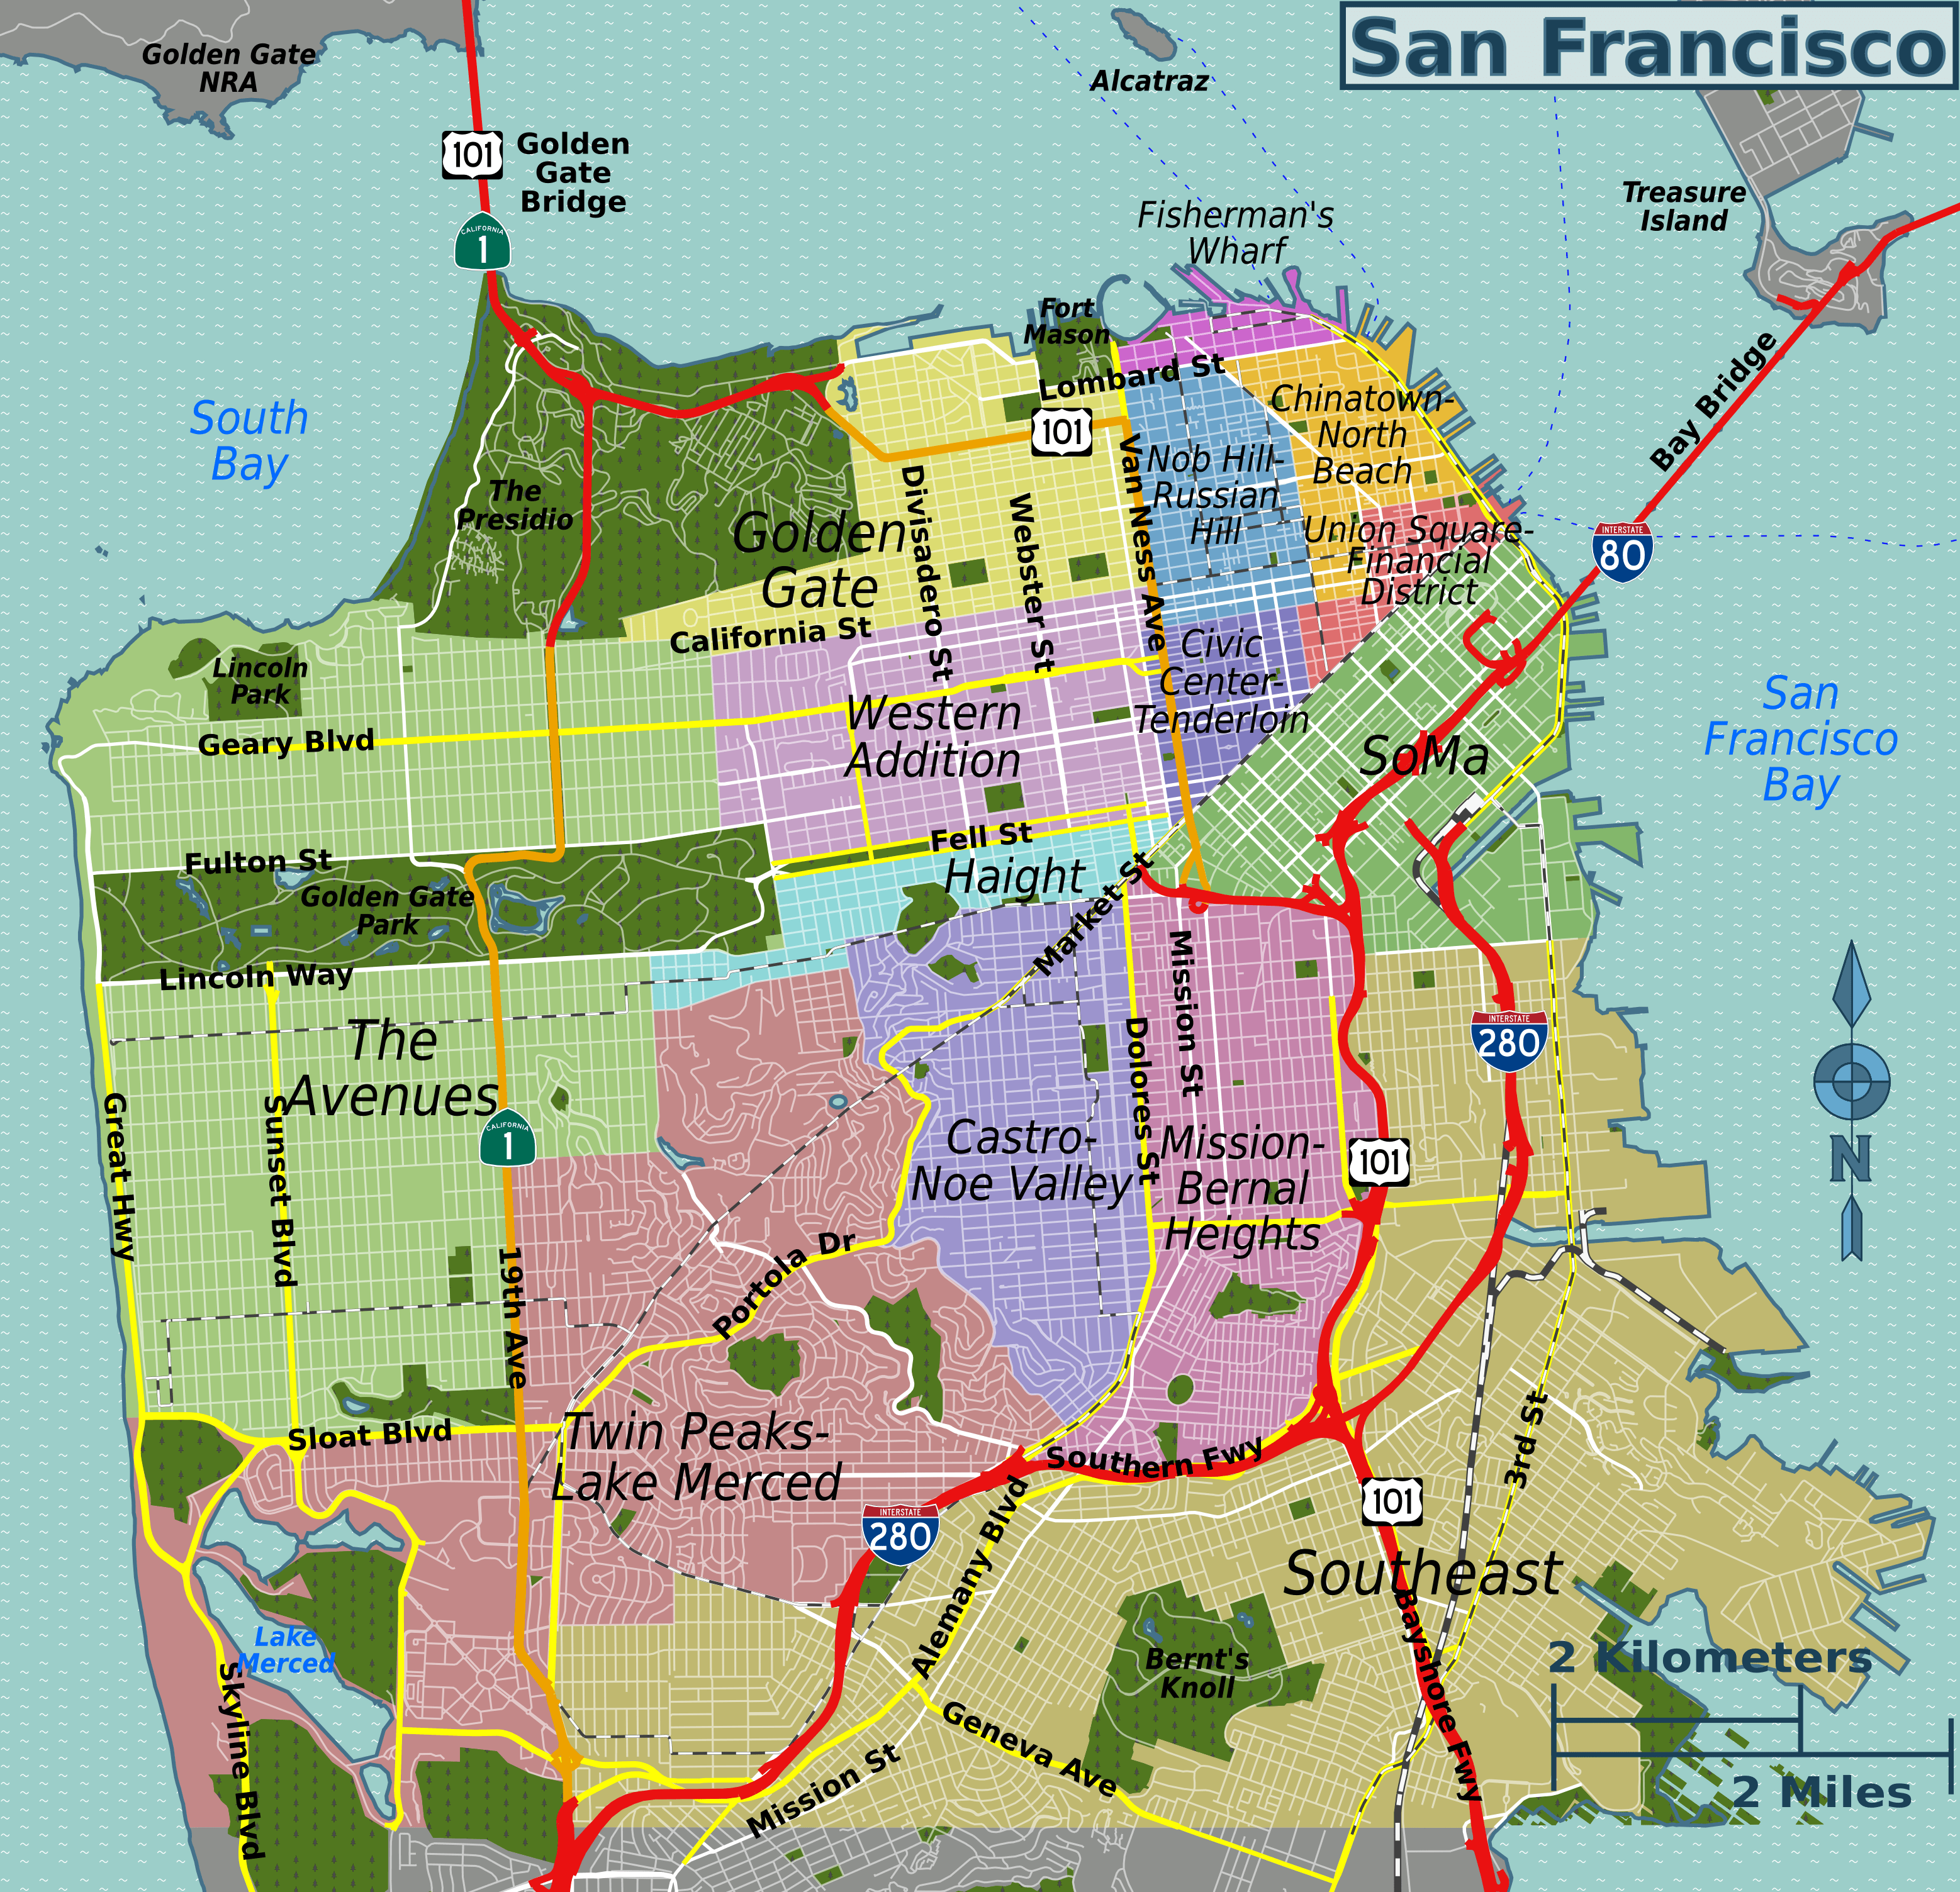
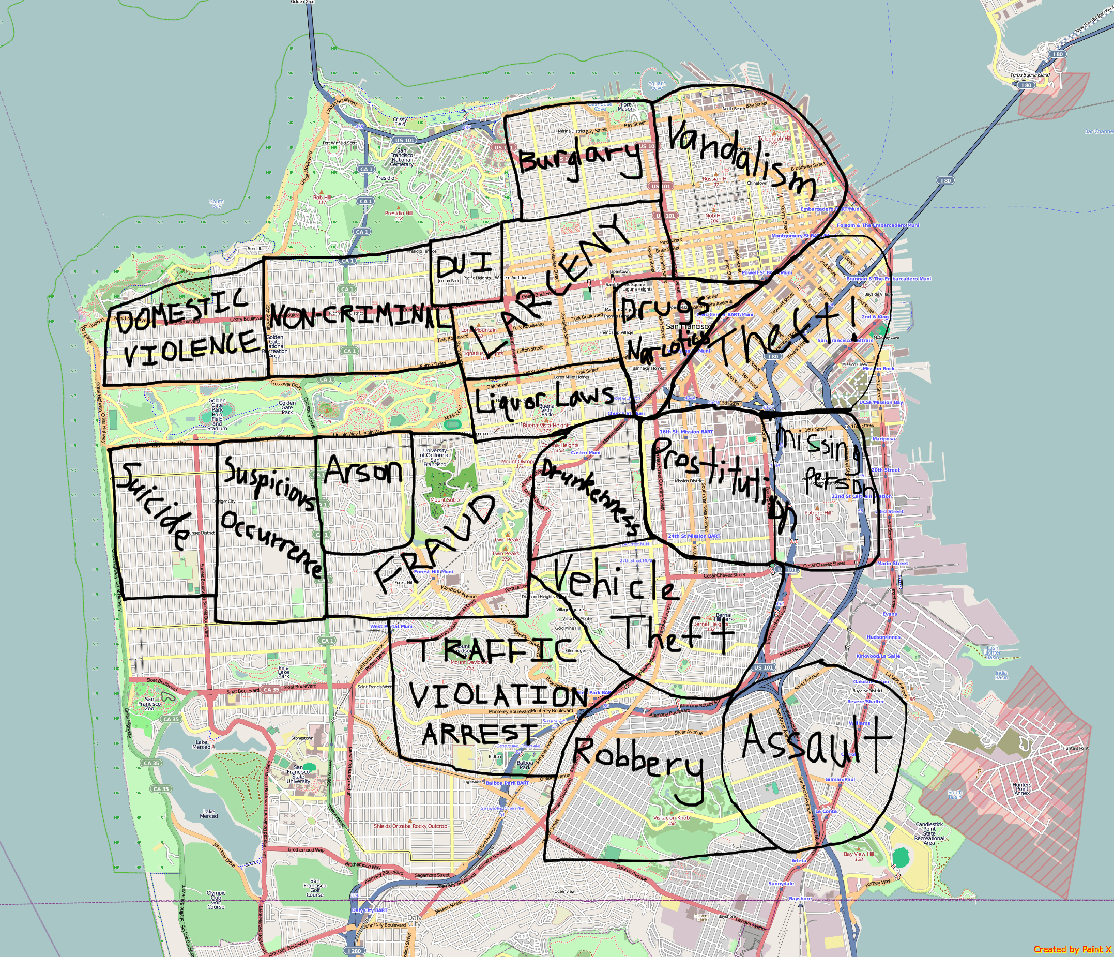
Predicting Crime Category In San Francisco Bay Area
Group Members: Anindita Mozumder James Morgan Nithin Reddy Prashant Sharma Santhosh K Jagadish Srikar Potta Stuti Nanda

Slide 2
Predicting Crime Category In San Francisco Bay Area
Group Members: Anindita Mozumder James Morgan Nithin Reddy Prashant Sharma Santosh K Jagadish Srikar Potta Stuti Nanda

Slide 3
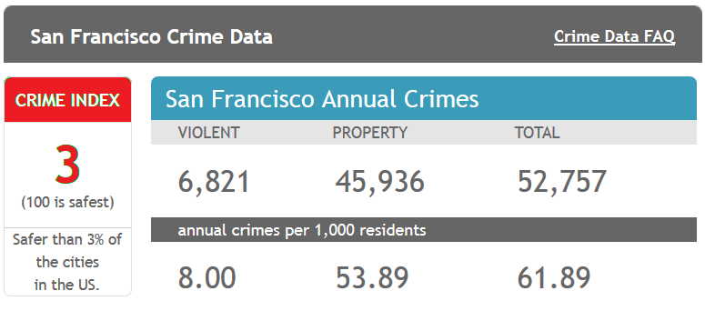
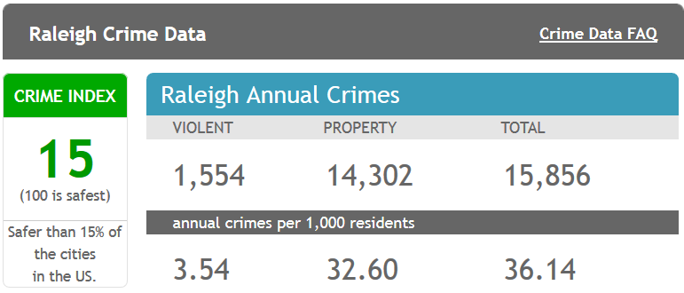
Background
From 1934 to 1963, San Francisco was infamous for housing notorious criminals
Rising wealth inequality, housing shortages responsible for increasing crime rate
The Kaggle’s dataset provides nearly 12 years of crime reports from across all of San Francisco's neighborhoods
Source: http://www.neighborhoodscout.com/ca/san-francisco/crime/

Slide 4

Objective
Given the historical crime data (time and location) predict the category of crime that occurred.
Utilize skills and knowledge gained in CSC522 to
Perform EDA to understand training data
Select and implement set of classification algorithms
Validate and Evaluate classification models
Predict the Crime Category

Slide 5
State of the art (1 slide)
What is the current state of the art techniques to solve your problem?
This should lead to your choice of techniques, and experimental design; so justify accordingly

Slide 6
Classification using Meth_Name
Describe your method(s)
Method we are using along with tuning param
How different it is from state of the art
What is unique about your method
If you have improved a method, how have you improved it?
Have you used any parallel/distributed setup (describe system configuration)
This may change from project to project, so put appropriate materials

Slide 7
Classification using Meth_Name
Describe your method(s)
Method we are using along with tuning param
How different it is from state of the art
What is unique about your method
If you have improved a method, how have you improved it?
Have you used any parallel/distributed setup (describe system configuration)
This may change from project to project, so put appropriate materials

Slide 8
Results (max: 2 slides)
Classifier | Accuracy | Methodology | Top Recall | Top Precision | Pros/Cons
Decision Tree |  | `
SVM
Neural
Random Forest
Logistic Regression

Slide 9
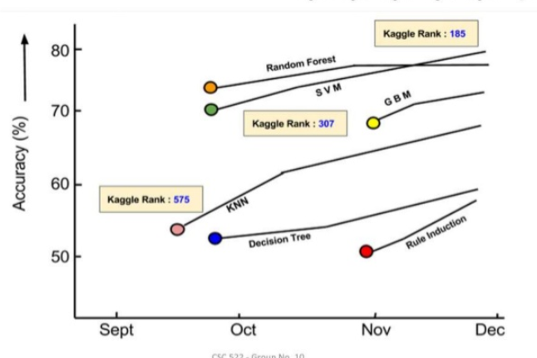
Results (max: 2 slides)
Use appropriate visualization techniques – We will use graph like this
How did you validate your results? (What kind of validation measure did you use?) –To ask

Slide 10
Conclusions and Future Work (max 1 slide)
What are the conclusions drawn from your method/results?
How can you improve your method further?
Try to tell after doing this work, how your learning goals achieved; and if you have to redo this work, what would you do differently

Slide 11
Remember
Be consistent with fonts, figures, etc. Don’t make font size smaller than 16.
Don’t cram too much details into slides
Don’t go beyond allocated time of 10 minutes.
Try to impress your peers, they are the ones who is going grade your presentation
Every one: use the supplied grading sheet (please note that this activity will considered as class participation and count towards bonus)

